Slide 1
Ultrasonic Radar and Detection System
Irving Becerril
IECE 453

Slide 2
Abstract
The system is designed to detect and visually represent objects within the range of the ultrasonic sensor attached to a stepper motor. As the sensor scans the surrounding area, a black bar, that represents the scanning position, appears on the LCD screen. If an object is detected by the sensor, the corresponding area on the LCD screen will turn on, while a buzzer also starts beeping. The rate at which it beeps corresponds to the objects distance. This system can be applied in any areas that require obstacle detection, monitoring, and security.

Slide 3
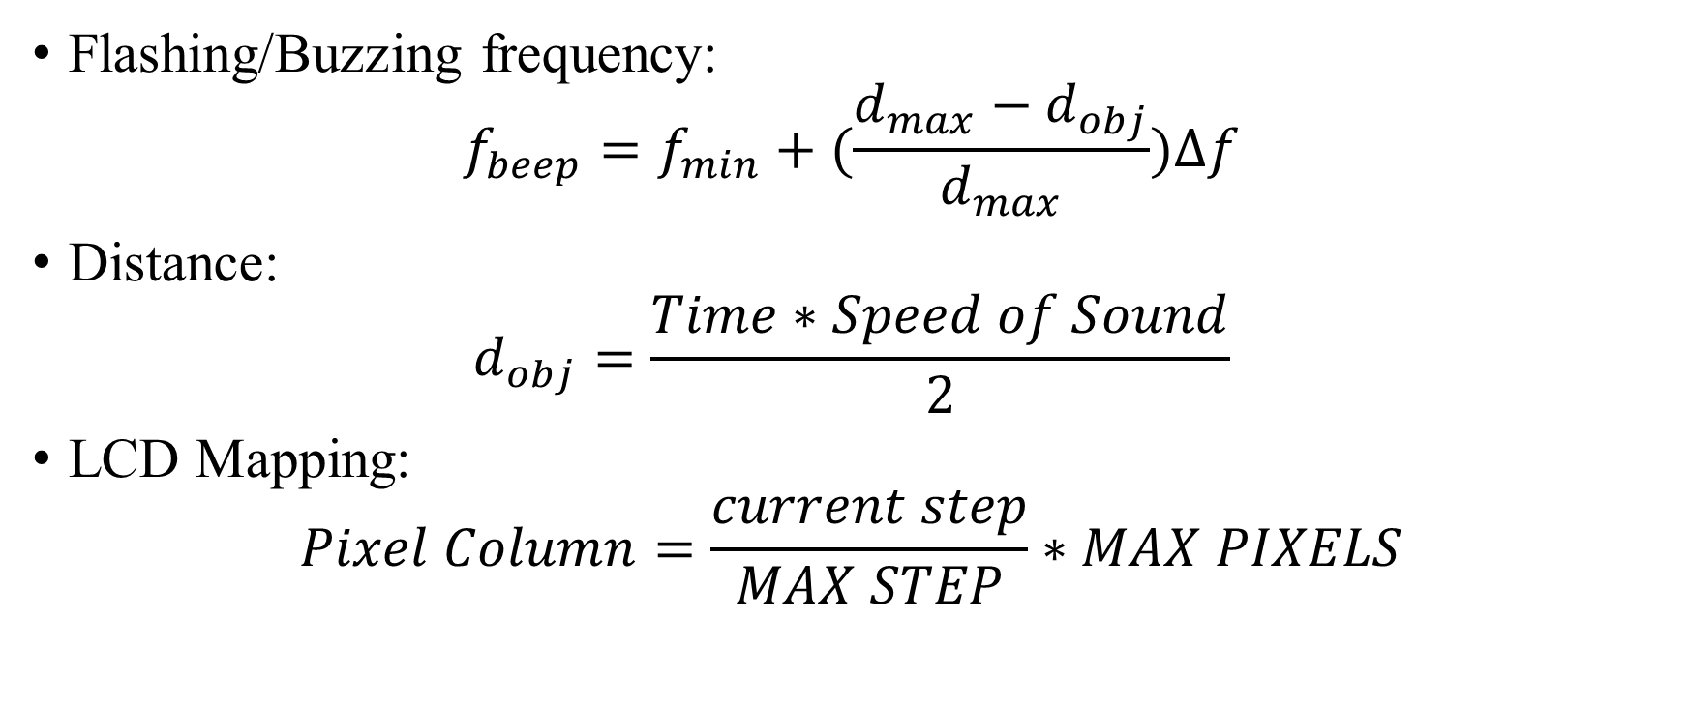
Equations
Flashing/Buzzing frequency:
$$f_{beep}=f_{min}+(\frac{d_{max}−d_{obj}}{d_{max}})∆f$$
Distance:
$$d_{obj}=\frac{Time∗Speed of Sound}{2}$$
LCD Mapping:
$$Pixel Column=\frac{current step}{MAX STEP}∗MAX PIXELS$$

Slide 4
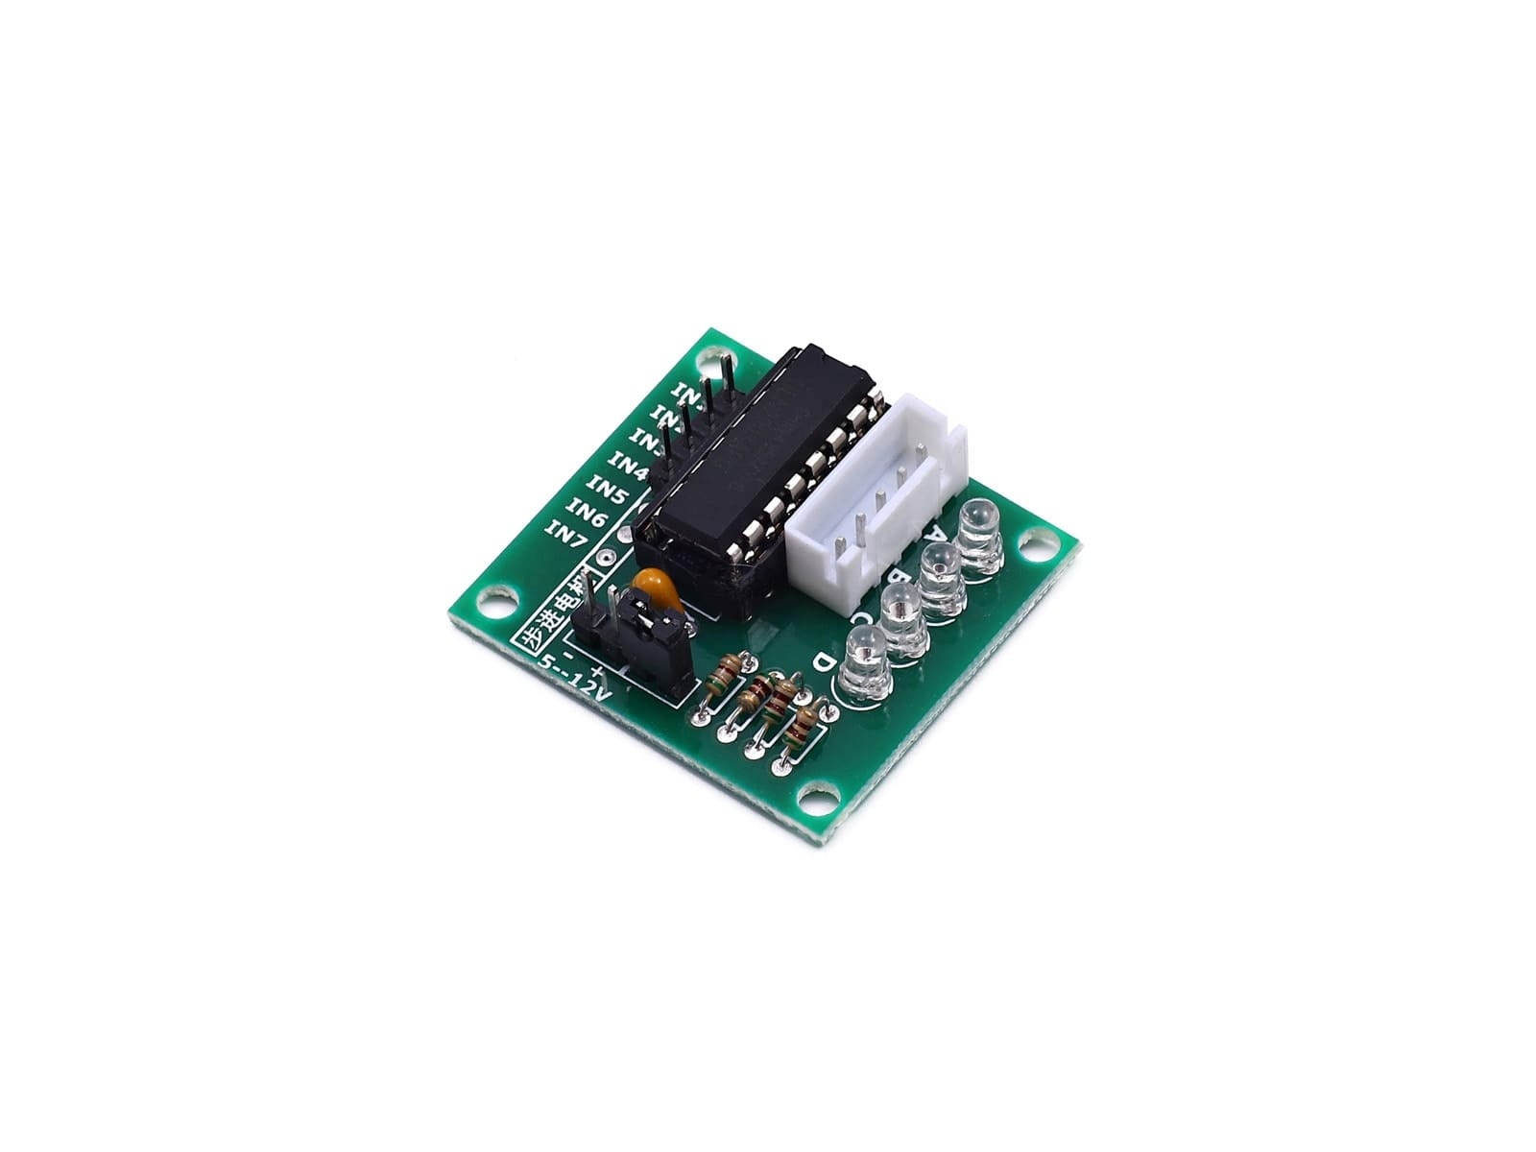
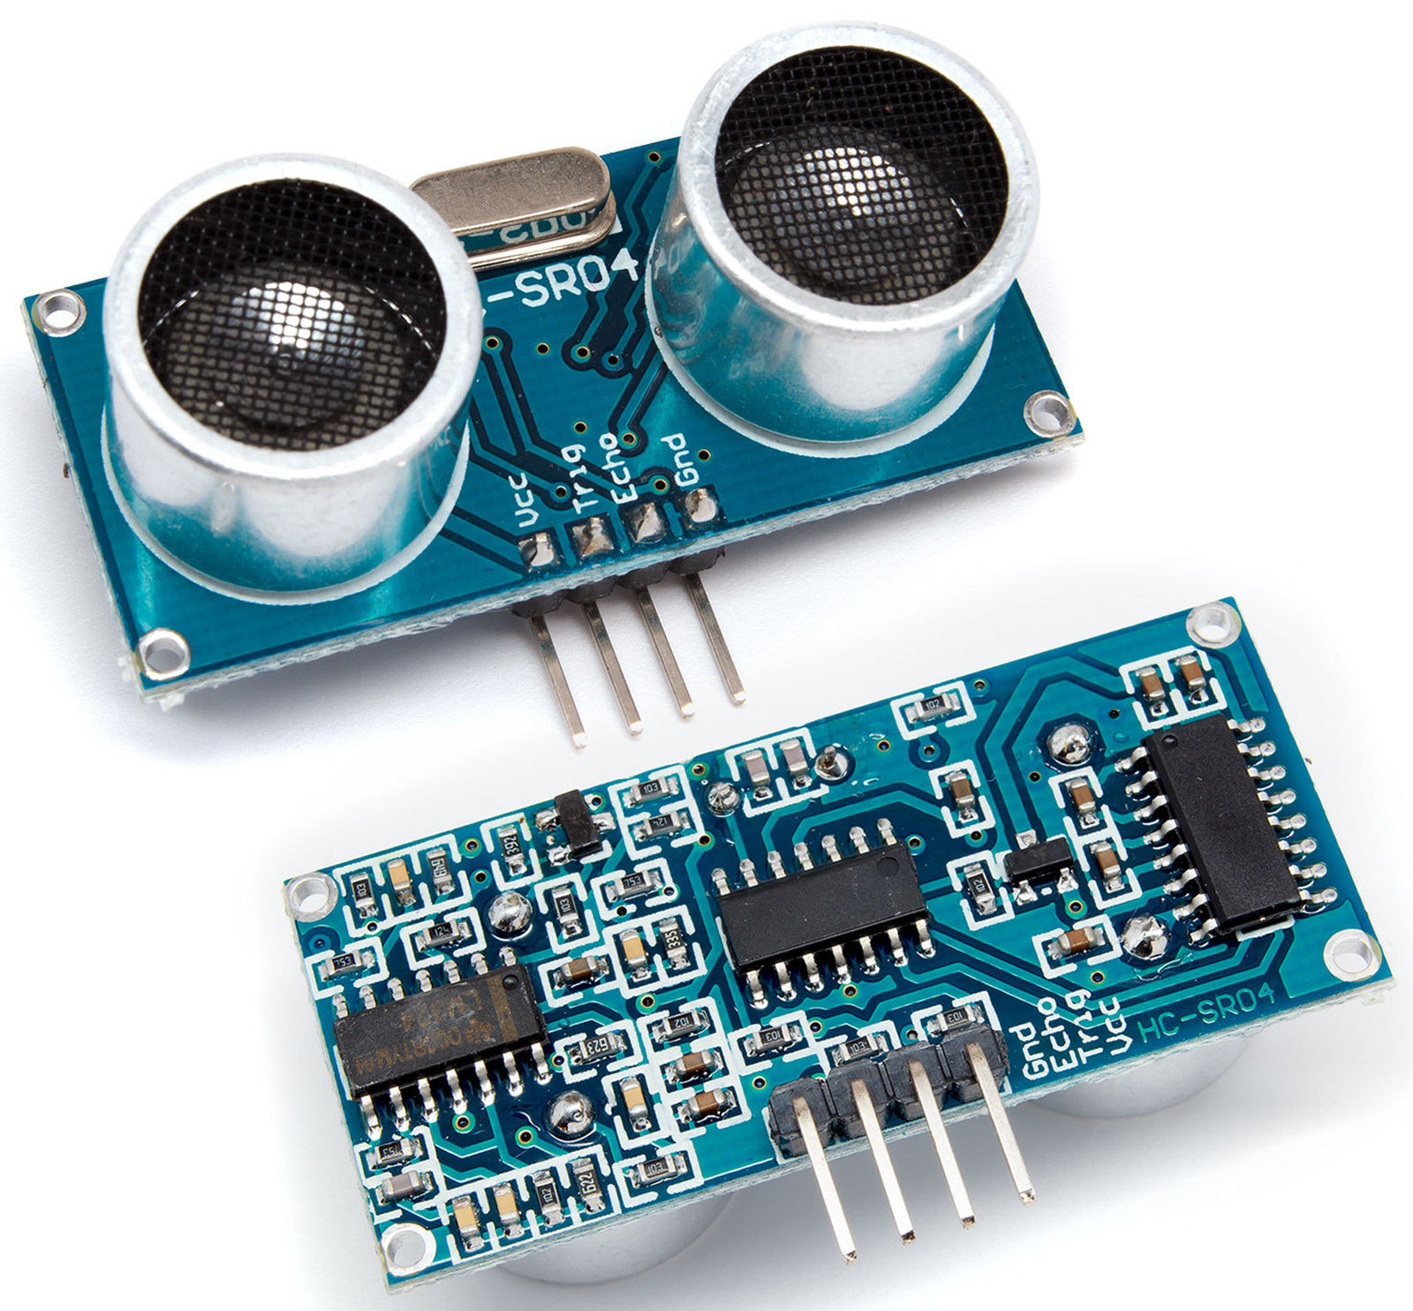
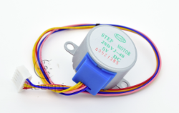
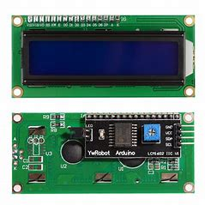
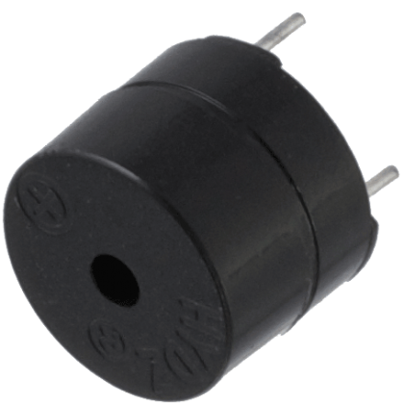
Components
Sensors
Ultrasonic Sensor – HC SR04
Actuators
Stepper Motor
Display/Output Device
LCD Display
Buzzer
Other
I2C Module
ULN 2003A

Slide 5
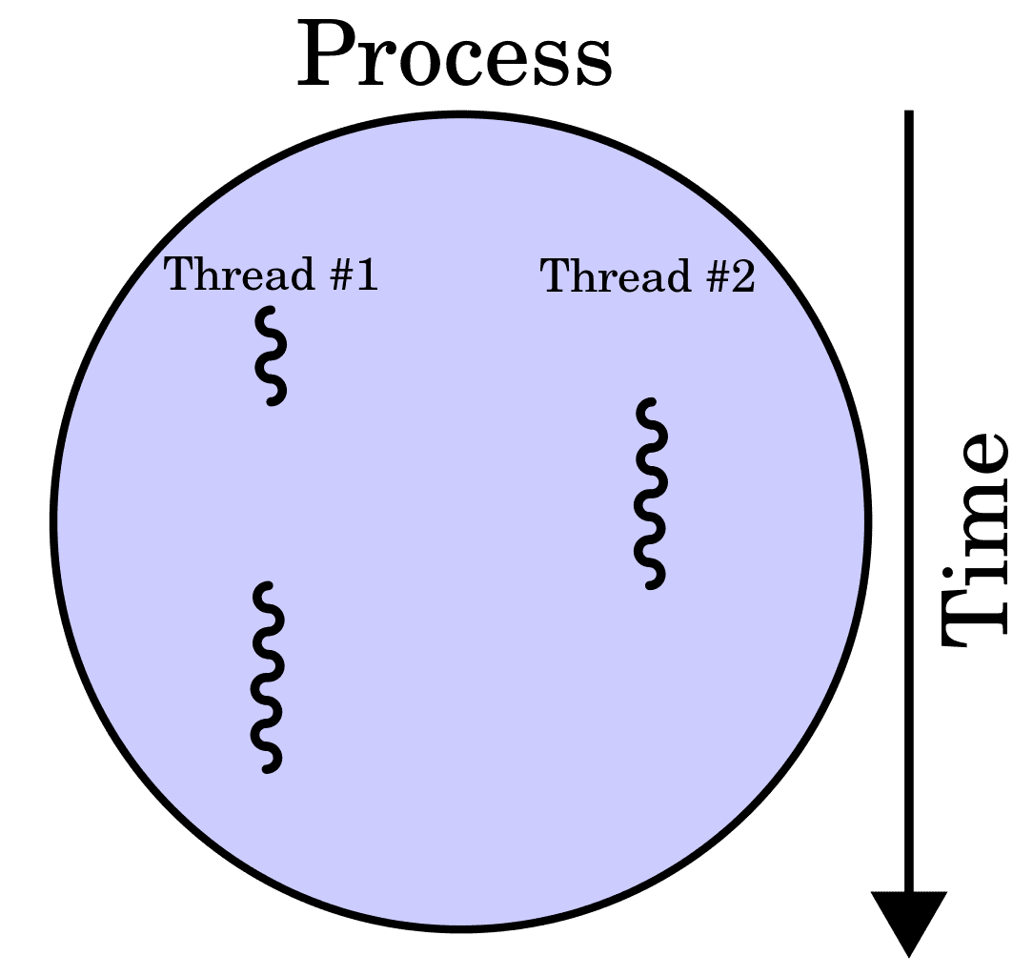
FSMs & Threading

Slide 6
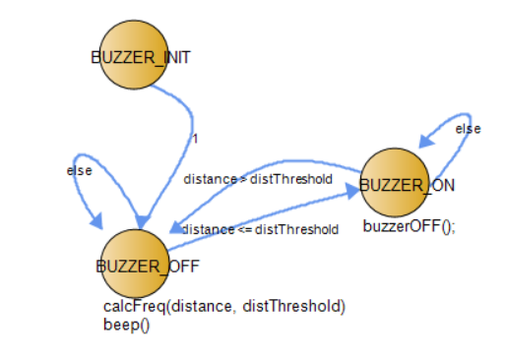
Buzzer FSM

Slide 7
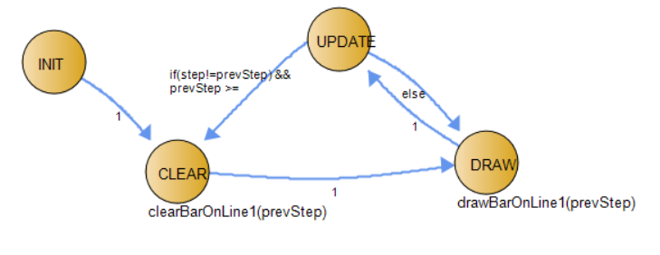
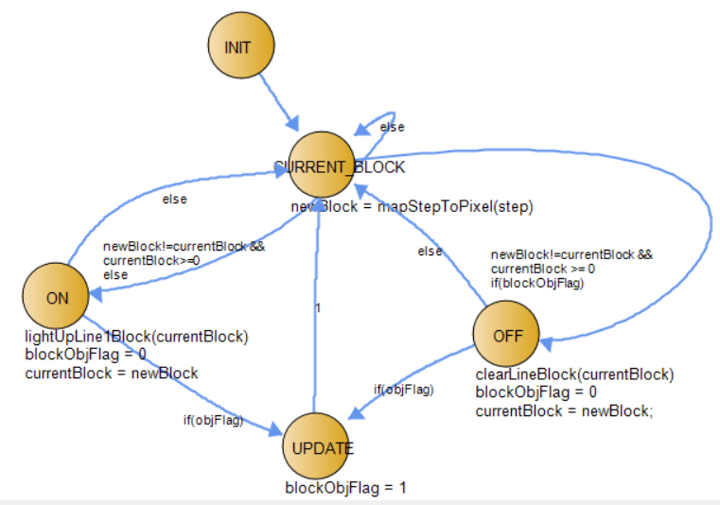
LCD FSMs

Slide 8
continued...

Slide 9
continued…

Slide 10
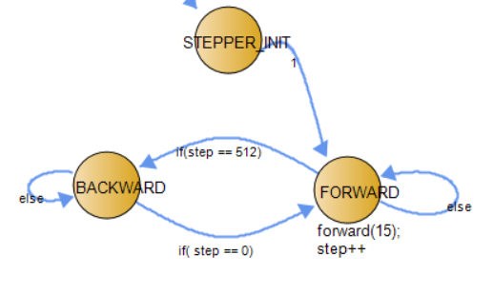
Motor FSM

Slide 11
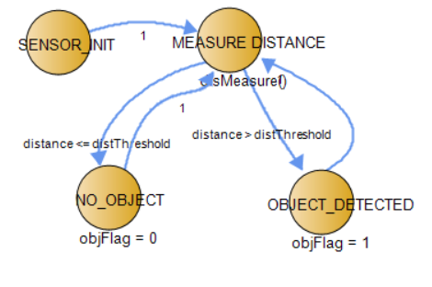
Ultrasonic Sensor FSM

Slide 12
Live Demo
**INSERT VIDEO DEMO**

